Slide 1
Online Event Registration
Mini-Project

Slide 2
Guided by
Mrs. R. Vidhya Lakshmi, M.C.A., M.Phil., SET,
Presented by
R. Karthick

Slide 3
Objective
Online Event Registration System is a web-based application that allows users to register for events online. The system is designed to streamline the event registration process and to provide a central location for event information. The Online Event Registration System is a convenient and easy-to-use tool that will save time and hassle for both event organizers and participant

Slide 4
Goals
Create a user-friendly registration process.
Increase event attendance.
Collect accurate user data.
Provide timely customer support.
Reduce manual labor of staff.
Optimize the user experience.

Slide 5
Languages Used
HTML
CSS
JAVA SCRIPT
PHP
MDBOOTSTRAP

Slide 6
Modules
Home page
Event Page
Admin page
Contact us
Event details
Feedback

Slide 7
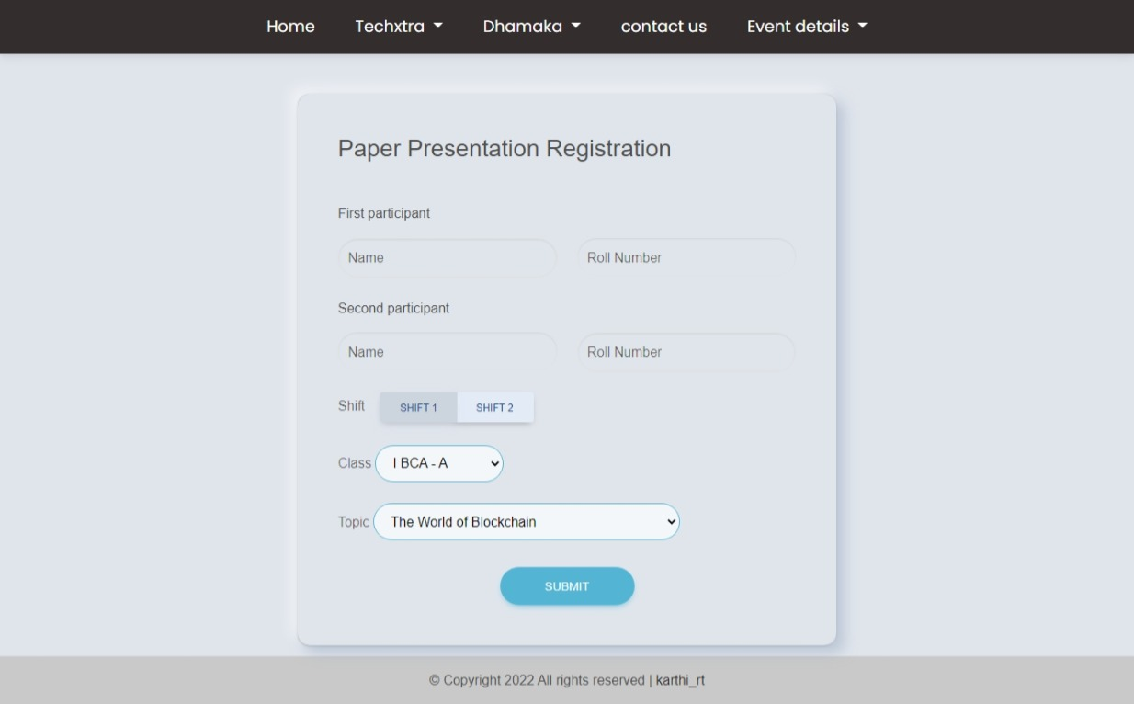
output

Slide 8
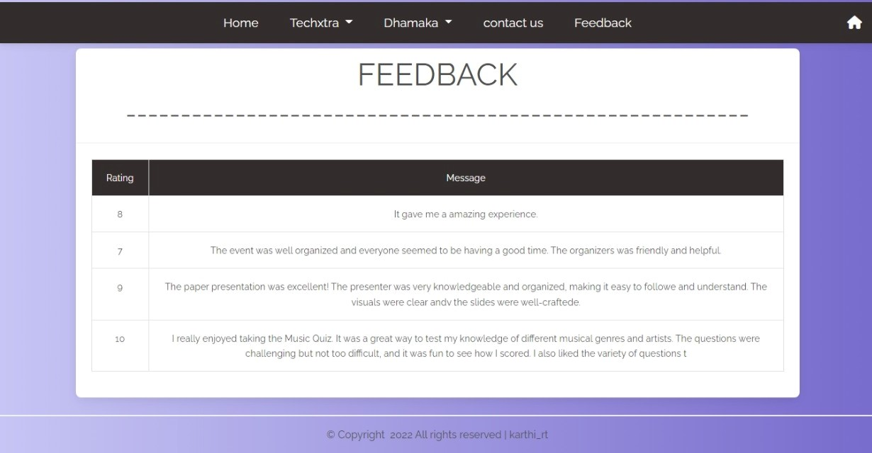

Slide 9
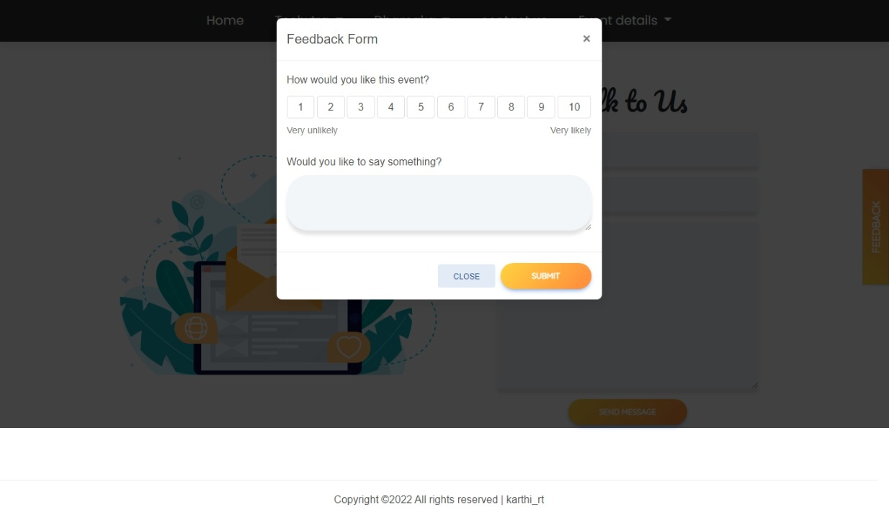

Slide 10
Thank You

